Slide 1
Advanced Data Centric Web Applications
Bachelor of Science (Honours) in Computing in Software Development
Bachelor of Science in Computing in Software
Development
Department of Computer Science & Applied Physics

Slide 2
Lecturer Gerard Harrison
Email Gerard.Harrison@gmit.ie
Office 344A
Lecture 1 hour per week
Labs 2 hours per week

Slide 3
Marking Scheme
Assessments 50%
Project 50%
100% CA – No end of semester exam.

Slide 4
Topics
Spring
Spring
A framework for the Java Platform.
Core Features can be used by any Java Application.
Extensions for building web applications on top of Java EE.
Spring MVC
Part of Spring and provides MVC architecture to develop flexible and loosely coupled web apps.
Spring Boot
A lightweight framework that takes most of the configuration work out of Spring applications.
Spring

Slide 5
Web Frameworks
Action/Request-based frameworks
Action/Request-based frameworks emphasise the request-response nature of HTTP.
Action/Request-based frameworks generally make it clear through their APIs that they're working with parsing an HTML request / generating an HTML response,
Component-based frameworks
Actions related to the same type of data are grouped into a Controller.
Component-based frameworks attempt to abstract the HTTP and treat the application as collections of components with renderers and actions to do things.

Slide 6
Spring Framework
The Spring Framework is a Java platform that provides comprehensive infrastructure support for developing Java applications.
Spring handles the infrastructure so you can focus on your application.
Spring enables you to build applications from "plain old Java objects" (POJOs) and to apply enterprise services non-invasively to POJOs.

Slide 7
Spring Framework
A Java application typically consists of objects that collaborate to form the application proper. Thus the objects in an application have dependencies on each other.
Although the Java platform provides a wealth of application development functionality, it lacks the means to organize the basic building blocks into a coherent whole, leaving that task to architects and developers.
Design Patterns such as Factory, Singleton etc. can be used but must be still be implemented in your application.

Slide 8
Spring Framework
The Spring Framework uses Inversion of Control (IoC) to formalise a means of composing disparate components into a fully working application.
The Spring Framework codifies formalized design patterns that you can integrate into your own application(s).

Slide 9
Spring Framework History
Created by Rod Johnson who released Spring in conjunction with his book Expert One-on-One J2EE Design and Development in October 2002.
Date | Spring Version
October 2002 | First Version
June 2003 | first released under the Apache 2.0 license
March 2004 | First Milestone release – 1.0
October 2006 | Spring 2.0
November 2007 | Spring 2.5
December 2009 | Spring 3.0
December 2011 | Spring 3.1
December 2012 | Spring 3.2
December 2013 | Spring 4.0
July 2015 | Spring 4.2
June 2016 | Spring 4.3
September 2017 | Spring 5.0

Slide 10
Spring Framework Features
Spring Framework is the most popular application development framework for enterprise Java.
It is Open Source.
Supports all major application servers.
Enables developers to develop enterprise-class applications using POJOs.
It is a well-designed web MVC framework.

Slide 11
Spring Framework Features
Based on a Dispatcher Servlet/Front Controller pattern.
Testing in Spring is simplified as environment-dependent code is moved out of the designer’s code and into the framework.

Slide 12
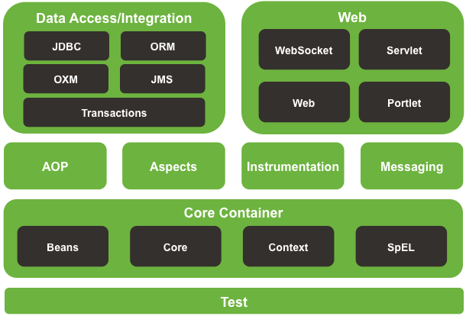
Spring Framework Architecture

Slide 13
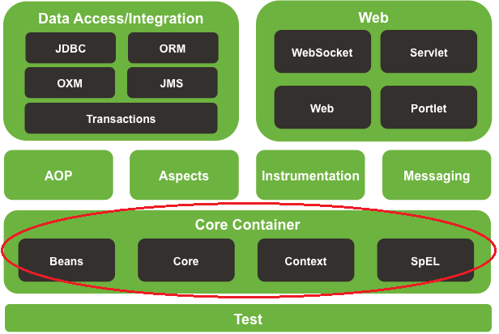
Spring Framework Architecture

Slide 14
Spring Framework Architecture Core Container
The Core Container consists of the following main modules:
spring-core
spring-beans
spring-context
spring-core and spring-beans are the most important modules and deal with Inversion of Control and Dependency Injection.
BeanFactory implements the Factory Pattern and allows the decoupling of the configuration and specification of dependencies from your actual program logic.

Slide 15
Spring Framework Architecture Context
The Context module is built upon the spring-core and spring-beans modules and adds support for:
Internationalisation
Event Propagation
Resource Loading
EJB (Enterprise Java Beans)
Integration of third-party libraries
Spring Expression Language (SpEL – similar to JSF expression language)

Slide 16
Spring Framework Architecture SpEL
The SpEL module provides a powerful Expression Language for querying and manipulating an object graph at runtime.
It is an extension of the unified expression language (unified EL) as specified in the JSP 2.1 specification.
The language supports setting and getting property values, property assignment, method invocation, accessing the content of arrays, collections and indexers, logical and arithmetic operators, named variables, and retrieval of objects by name from Spring’s IoC container. It also supports list projection and selection as well as common list aggregations.

Slide 17
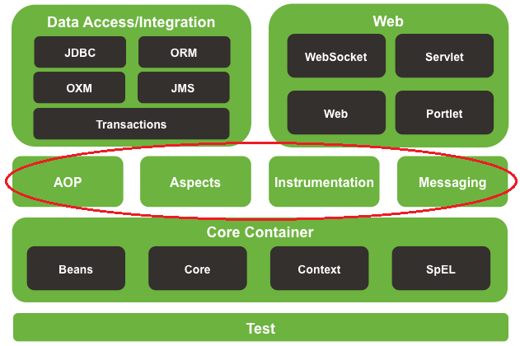
Spring Framework Architecture

Slide 18
Spring Framework Architecture AOP, Aspects, Instrumentation, Messaging
The AOP module provides support for Aspect Oriented Programming.
The Aspects module provides integration with AspectJ.
The Instrumentation module provides class instrumentation support and classloader implementations to be used in certain application servers.
The Messaging module provides a set of annotations for mapping messages to methods.

Slide 19
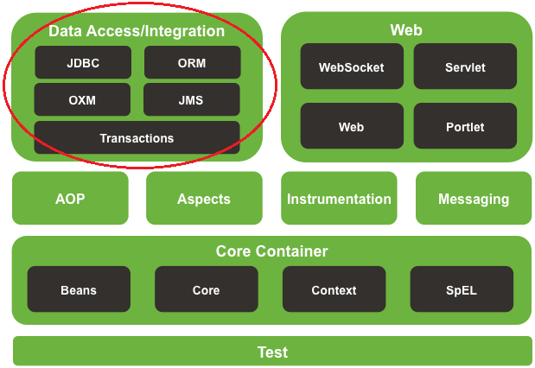
Spring Framework Architecture

Slide 20
Spring Framework Architecture Data Access/Integration
The JDBC module provides a JDBC abstraction layer to handle boilerplate code.
The Transactions module provides comprehensive transaction support across different transaction APIs such as Java Transaction API (JTA), JDBC, Hibernate, Java Persistence API (JPA), and Java Data Objects (JDO).
The ORM module provides integration layers for popular object-relational mapping APIs, including JPA, JDO, and Hibernate.
The OXM module provides an abstraction layer that supports Object/XML mapping implementations such as JAXB, Castor, XMLBeans, JiBX and XStream.
The JMS module contains features for producing and consuming messages.

Slide 21
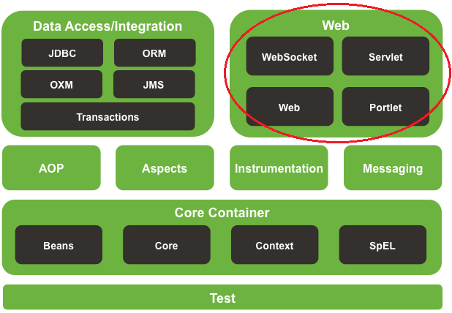
Spring Framework Architecture

Slide 22
Spring Framework Architecture Web
The Web layer contains basic web-oriented features, for example, Servlet listeners and a web-oriented application context.
It also contains an HTTP client and the web-related parts of Spring’s remoting support.
This layer also contains the MVC and REST Web Services implementation for web applications.

Slide 23
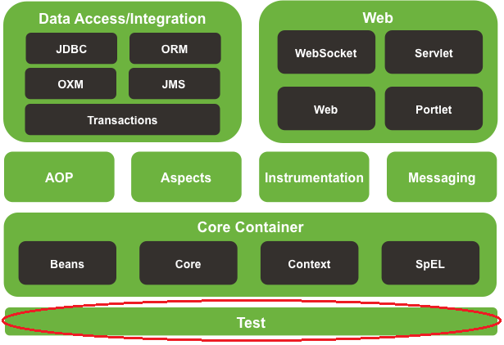
Spring Framework Architecture

Slide 24
Spring Framework Architecture Test
The Test module supports the unit testing and integration testing of Spring components with unit testing frameworks such as JUnit.

Slide 25
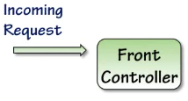
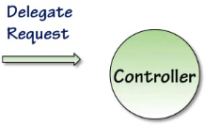
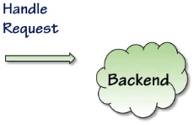



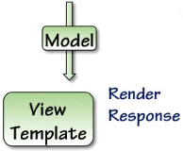

Request/Response Lifecycle

